Slide 1
Bennett University
School of Computer Science Engineering and Technology
CSET203 – Microprocessor and Computer Architecture
Course Type - Core L-T-P Format 3-0-2 Credits – 4

Slide 2
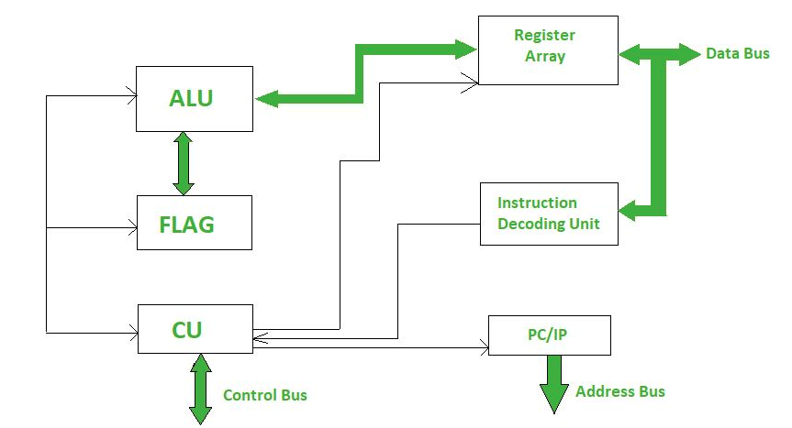
Basic Structure of Microprocessor

Slide 3
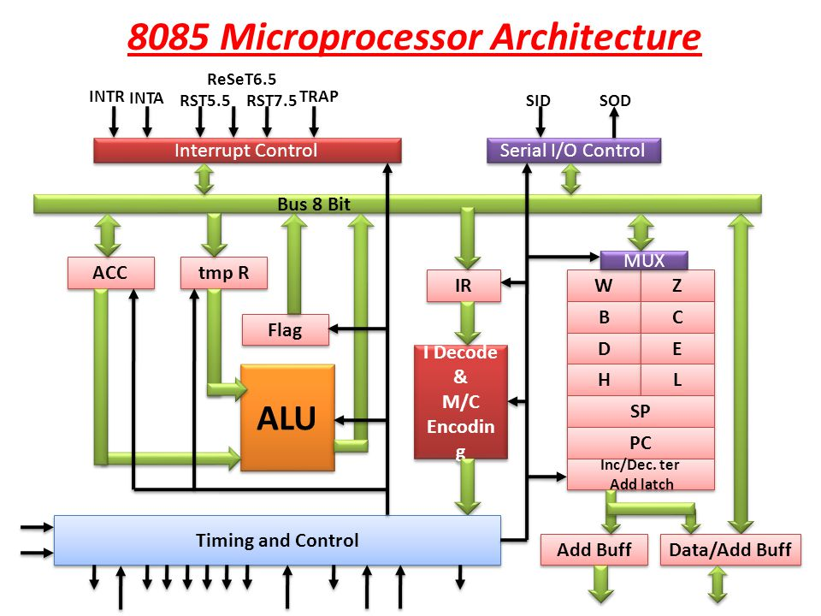







8085 Architecture

Slide 4
8085 Properties
8085 is pronounced as "eighty-eighty-five" microprocessor. It is an 8-bit microprocessor designed by Intel in 1977 using NMOS technology.
It has the following configuration −
8-bit data bus
16-bit address bus, which can address upto 64KB
A 16-bit program counter
A 16-bit stack pointer
Six 8-bit registers arranged in pairs: BC, DE, HL
Requires +5V supply to operate at 3.2 MHZ single phase clock
It is used in washing machines, microwave ovens, mobile phones, etc.

Slide 5
Accumulator
Accumulator is used to perform I/O, arithmetic, and logical operations.
It is connected to ALU and the internal data bus.
The accumulator is the heart of the microprocessor because for all arithmetic operations.
Accumulator’s 8-bit pin will always there connected with ALU and in most-off times all the operations carried by different instructions will be stored in the accumulator after operation performance.

Slide 6
Arithmetic and Logical Unit (ALU)
ALU is a main component of the central processing unit, which stands for arithmetic logic unit and performs arithmetic and logic operations.
It is also known as an integer unit (IU) that is an integrated circuit within a CPU or GPU, which is the last component to perform calculations in the processor.
It can perform all processes related to arithmetic and logic operations such as addition, subtraction, and shifting operations, including Boolean comparisons (XOR, OR, AND, and NOT operations).
some ALUs are designed to perform only integer calculations, and some are for floating-point operations.
Some processors include a single arithmetic logic unit to perform operations, and others may contain numerous ALUs to complete calculations.

Slide 7
ALU Operations
Logical Operations: The logical operations consist of NOR, NOT, AND, NAND, OR, XOR, and more.
Bit-Shifting Operations: It is responsible for displacement in the locations of the bits to the by right or left by a certain number of places that are known as a multiplication operation.
Arithmetic Operations: Although it performs multiplication and division, this refers to bit addition and subtraction. But multiplication and division operations are more costly to make. In the place of multiplication, addition can be used as a substitute and subtraction for division.

Slide 8
Advantages and Disadvantages of ALU
Advantages
It supports parallel architecture and applications with high performance.
In general, it is very fast; hence, it provides results quickly.
There are no sensitivity issues and no memory wastage with ALU.
They are less expensive and minimize the logic gate requirements.
Disadvantages
With the ALU, floating variables have more delays, and the designed controller is not easy to understand.
A proven disadvantage of ALU is that there are irregularities in latencies.
Another demerit is rounding off, which impacts accuracy.

Slide 9
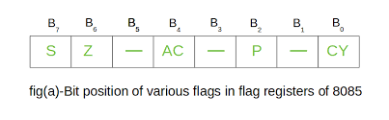
FLAG REGISTER
A flag is one or more data bits used to store binary values as specific program structure indicators. A flag is a component of a programming language's data structure.
A computer interprets a flag value in relative terms or based on the data structure presented during processing and uses the flag to mark a specific data structure. Thus, the flag value directly impacts the processing outcome.
The Flag register is a Special Purpose Register. Depending upon the value of the result after any arithmetic and logical operation, the flag bits become set (1) or reset (0).

Slide 10
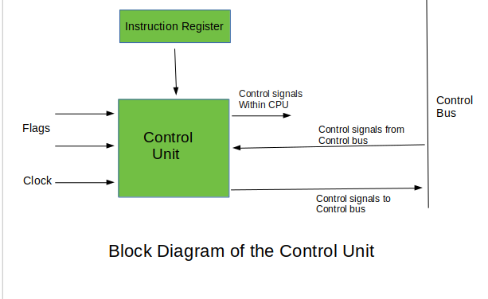
Control Unit
The control unit of a microprocessor directs the operation of the other units by providing timing and control signals.
It is the function of the microcomputer to execute programs which are stored in memory in the form of instructions and data.
The control unit contains the necessary logic to interpret instructions and to generate the signals necessary for the execution of those instructions.
The descriptive words "fetch" and "execute" are used to describe the actions of the control unit. It fetches an instruction by sending and address and a read command to the memory unit.
The instruction at that memory address is transferred to the control unit for decoding. It then generates the necessary signals to execute the instruction.
The two major operations performed by the control unit are instruction interpretation and instruction sequencing.

Slide 11
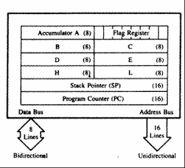
Register Array
A register is a very small amount of very fast memory that is built into the CPU (central processing unit) in order to speed up its operations by providing quick access to commonly used values.
The instruction set architecture of a CPU will almost always define a set of registers which are used to stage data between memory and the functional units on the chip.

Slide 12
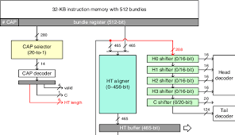
Instruction/Decoding Unit
The Instruction Decode Unit (IDU) is a functional unit of a processor that converts the machine code into individual instructions that can be executed by the processor.
The Instruction Decoder reads the next instruction in from memory and sends the component pieces of that instruction to the necessary destinations.

Slide 13
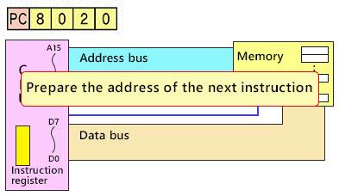
Program Counter/Instruction Pointer
PC is a 16-bit register. It contains a memory address. PC contains that very memory address from where the next instruction is to be fetched for execution.
The instruction pointer is incremented after fetching an instruction and holds the memory address of ("points to") the next instruction that would be executed. (In a processor where the incrementation precedes the fetch, instruction pointer points to the current instruction being executed.)

Slide 14
Interrupt Control
Whenever a microprocessor is executing the main program and if suddenly an interrupt occurs, the microprocessor shifts the control from the main program to process the incoming request.
After the request is completed, the control goes back to the main program. There are 5 interrupt signals in 8085 microprocessors: INTR, TRAP, RST 7.5, RST 6.5, and RST 5.5.
Priorities of Interrupts: TRAP > RST 7.5 > RST 6.5 > RST 5.5 > INTR

Slide 15
Timing and Control Unit
The timing and control unit comes under the CPU section.
It controls the flow of data from the CPU to other devices.
It is also used to control the operations performed by the microprocessor and the devices connected to it.
Following are the timing and control signals, which control external and internal circuits −
Control Signals: READY, RD’, WR’, ALE
Status Signals: S0, S1, IO/M’
DMA Signals: HOLD, HLDA
RESET Signals: RESET IN, RESET OUT

Slide 16

Thank You and Queries

